Slide 1

BY –A K CHOUBEY
CLASS SUBJECT
– VIII
– PHYSICS (SCIENCE)

Slide 2

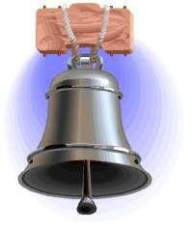
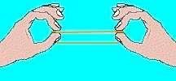
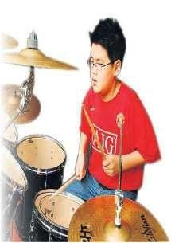
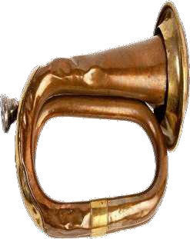


Sound is a form of energy produce by vibrations.
Sound plays an important part in our daily lives. It helps us to communicate with each other. We hear a wide variety of sounds in our surroundings.
Sound is produced by a vibrating body.
Vibration is the to and fro or back and forth motion of an object.
Eg :- If you strike a school bell, it vibrates and produces sound.
If you pluck a stretched rubber band, it vibrates and produces sound.
If you beat a drum, its stretched membrane vibrates and produces sound. If you blow a bugle, the air column vibrates and produces sound.
2

Slide 3

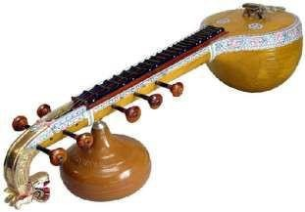
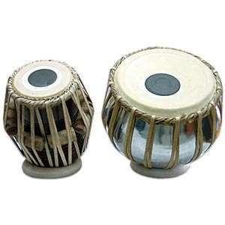
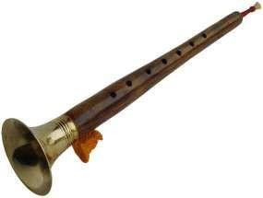
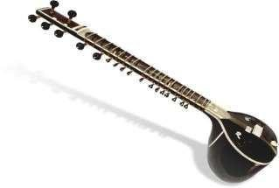
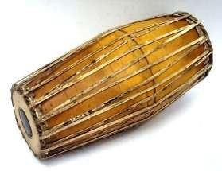
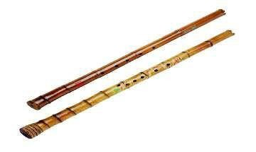
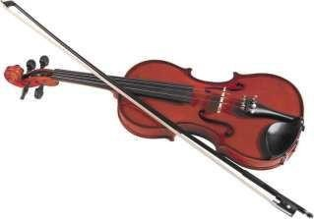
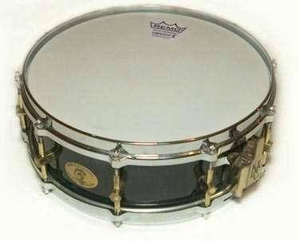
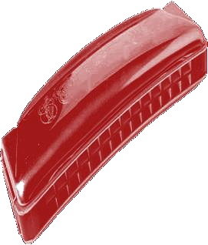

3
Saturday,December 16, 2017

Slide 4


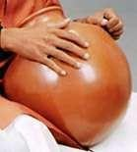
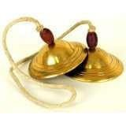
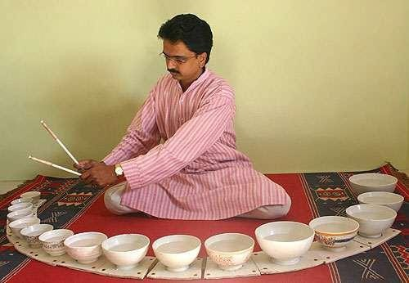

Some musical instruments produce sound when they are beaten or struck.
Eg:- bell, ghatam, manjira, jaltarang etc.

Slide 5





Sl.No. | Musical instrument | Vibrating part producing sound
1 | Veena | Stretched string
2 | Sitar | Stretched string
3 | Violin | Stretched string
4 | Guitar | Stretched string
4 | Tabala | Stretched membrane
5 | Mridangam | Stretched membrane
6 | Drum | Stretched membrane
7 | Shehnai | Air column
8 | Flute | Air column
9 | Mouth organ | Air column

Slide 6
6

Slide 7



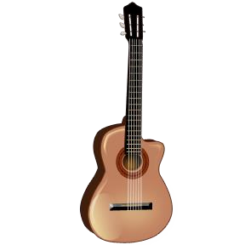
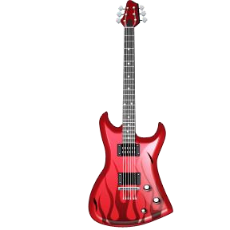



◻ Strings Instruments make music by plucking or strumming (झनकार) the strings.
Electric Guitar
Violin
Cello
Guitar
Harp
7
Saturday, December 16, 2017

Slide 8


Speed of a sound depends on the
ELASTICITY-The ability of an object or material to resume its normal shape after being stretched or compressed
The Density Of The Medium through which it propagates
In case of air, it also depends upon the temperature of air.
The speed of sound through air is about 330 m/s. The speed of sound through water is about 1500 m/s. The speed of sound in
Solid > liquid >
gases
The speed of sound in gas is least.
Relationship between Speed (v), frequency (٧) and wave length (λ)
Speed = wave length x frequency v = λ x ٧

Slide 9



The speed of sound in air is about 330 m/s. The speed of light in air is about 3 * 10⁸ m/s. Speed of light is faster than speed of sound.
That is why the thundering sounds are always heard a little after seeing the flash of lightning.
Both lightening & thundering occur together.
Delay in hearing is due to the difference in the speeds of sound and light.

Slide 10


State | Substance | Speed in m/s
Solid | Aluminium | 6420
 | Steel | 5960
 | Iron | 5950
 | Brass | 4700
 | Glass | 3980
Liquid | Water (Sea) | 1531
 | Water (Distilled) | 1498
 | Ethanol | 1207
 | Methanol | 1103
Gas | Hydrogen | 1284
 | Helium | 965
 | Air | 346
 | Oxygen | 316
 | Sulphur dioxide | 213

Slide 11




Vibration is the to and fro or back and forth motion of an object.
Vibration is also called oscillatory motion.
A
B
The motion of the pendulum from one extreme position to the other extreme position and back is called an oscillation. (A to B and back to A)
O
Motion of a simple pendulum

Slide 12




The time taken for one oscillation is called time period. It is represented by the letter T.
The SI unit is second (s).
Frequency and time are represented as follows
𝟏
T = _{٧}
٧ for one oscillation
٧ = ^{𝟏}
𝑻
A
B
O
Motion of a simple pendulum

Slide 13

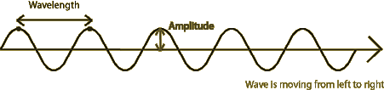

The maximum displacement of an oscillating body from its central position is called its amplitude. (OB or OA)
OR
The amplitude of sound wave is the height of the crest or tough.
It is represented by the letter A.
The SI unit is the same as that of density or pressure.
Wave disturbance
A
B
O
Motion of a simple pendulum

Slide 14

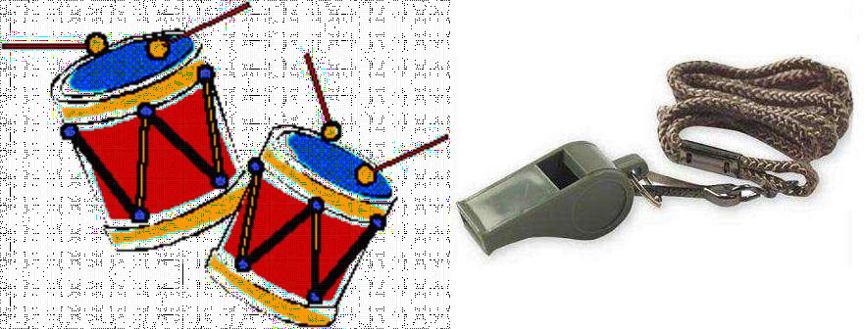

i)The loudness of sound depends upon the amplitude of vibration.
If the amplitude is less the sound is feeble. If the amplitude is more the sound is loud. The unit of loudness is called decibel (dB).
ii)The pitch of sound (shrillness or flatness) depends upon the
frequency of vibration.
If the frequency is less the sound has low pitch. Eg :- sound of a drum, sound of an adult etc.
If the frequency is more the sound has a high pitch. Eg :- sound of a whistle, sound of a baby etc.

Slide 15



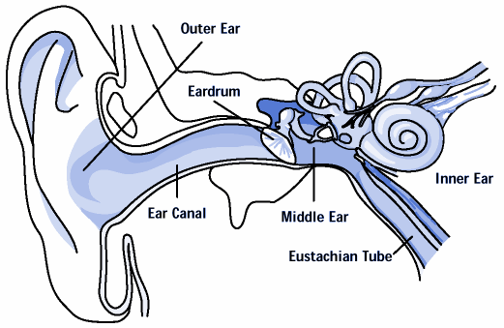

HUMAN EARS
HOW WE HEAR SOUND THROUGH OUR EARS ?
Sound enters the ear through the ear canal. It makes the eardrum to vibrate. The ear drum sends the vibrations to the inner ear. From there the signals go to the brain and then we hear the sound.

Slide 16




The sensation of hearing of any sound persists in our brain for 0.1s.This is called the persistence of hearing.
Persistence of hearing helps us to get a feeling of continuity while hearing one sound after another. Due to Persistence of hearing the direct original
sound and reflected sound reaching ear in lesser times than 0.1 sec mingle together & do not produce any separate sound of their own. This saves us from confusion & difficulty

Slide 17


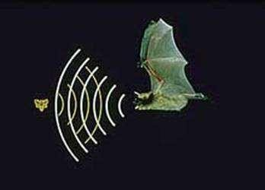

1) Audible sound is sound which we can hear. It has frequencies between 20 Hz and 20000 Hz.
2) Inaudible sound is sound which we cannot hear.
It has frequencies less than 20Hz and more than 20000 Hz.
Sound whose frequencies are more than 20000 Hz is called ultasound.
ultrasonic sound.
Some animals like dogs can hear ultrasonic sound. Bats produce ultrasonic sound.

Slide 18



Human beings can hear sound frequencies between 20 Hz and 20000 Hz.
Sound whose frequency is less than 20 Hz is called infrasonic sound. Animals like dogs, elephants, rhinoceros, whales etc. produce and hear infrasonic sound.
Sound whose frequency is more than 20000 Hz is called ultrasonic sound. Animals like dolphins, bats, rats porpoises etc. produce and hear ultrasonic sound.
Bats use reflection of ultrasonic sound waves to detect an obstacle or its prey.

Slide 19


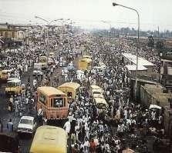
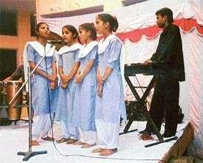
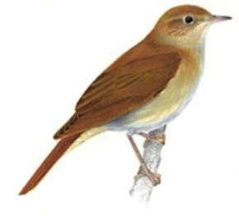

1) Noise - Unpleasant sounds are called noise.
It is produced by irregular or non-periodic vibrations.
Eg :- If all the students in a classroom speak together, a
noise is produced.
Sounds produced by horns of busses and trucks.
2) Musical sound - Sound which is pleasing to the ears is
called musical sound.
It is produced by regular or periodic vibrations.
Eg :- Sounds produced by musical instruments. Sound of a person singing a song.
Nightingale

Slide 20


The presence of excessive or unwanted (undesirable) sound in the environment is called noise pollution.
Causes of noise pollution :-Noise pollution is caused by sounds of vehicles, explosions including brusting of crackers, machines, loudspeakers etc. In the home noise pollution is caused by television radio and music systems at high volume, some kitchen appliances, desert coolers, air conditioners etc.
Harmful effects of noise pollution :-
Noise pollution causes several health related problems like lack of sleep, hypertension, high blood pressure, anxiety etc. A person exposed to loud sound continuously may get temporary or permanent impairment of hearing.
Measures to limit noise pollution :-
Noise pollution can be reduced by using silencers in vehicles, industrial machines, and home appliances reducing use of vehicle horns, running TV, radio and music systems at low volumes. Planting of trees along roads and buildings also help to reduce noise pollution.

Slide 21

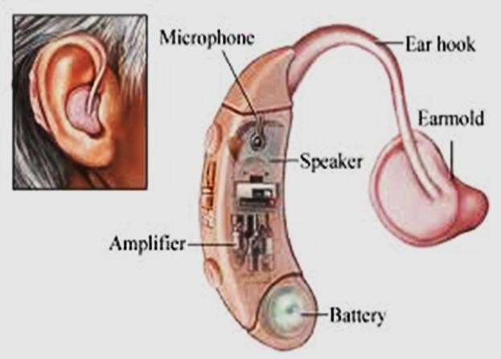
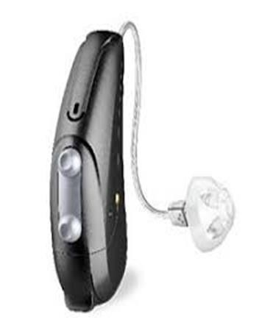

Hearing aid is an electronic battery operated device. It receives sound through its microphone, which convert these sound waves to electrical signals, these signal are amplified & given to the speaker of the hearing aid. The speaker converts this amplified signals back into sound. This amplified sound is then sent to the ear & this helps the affected person to hear it much more clearly.

Slide 22

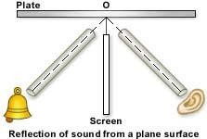
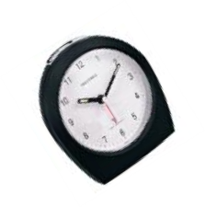

Like light, sound gets reflected at the surface of a solid or liquid and follows the laws of reflection.
The angle of incidence is equal to the angle of reflection.
The incident ray, the reflected ray and normal at the point of
incidence all lie in the same plane.
Activity :- Take two pipes of the same length and arrange them on a table near a wall or metal plate. Keep a clock near the open end of one pipe and try to hear the sound of the clock through the other pipe by adjusting the position of the pipe.
Now measure the angles of incidence and reflection. Then lift the second
pipe and try to hear the sound.
It will be seen that the angle of incidence is equal to the angle of reflection. The incident ray, the reflected ray and normal all lie in the same plane.

Slide 23


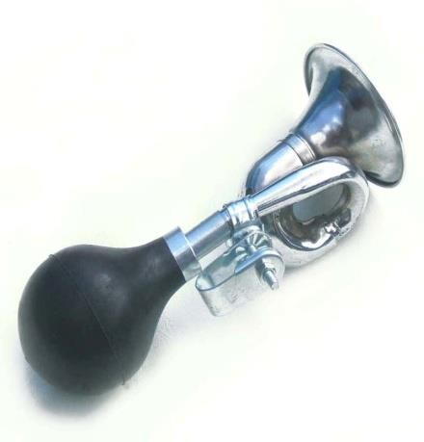

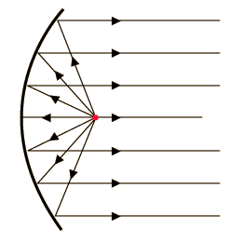

Megaphones, horns, musical instruments like trumpets, shehnais etc. are deigned to send sound by multiple reflection in a particular direction without spreading in all directions.
Doctors listen to sounds from the human body through a stethoscope. The sound of heartbeat reaches the doctor’s ears by multiple reflection.
Generally the ceilings of cinema halls and auditoriums are curved so that sound after multiple reflection reaches all parts of the hall. Sometimes a curved sound board is placed behind the stage so that sound after multiple reflection spreads evenly across the hall.

Slide 24

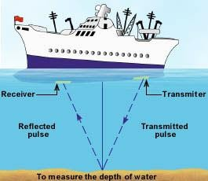

Sonar stands for Sound Navigation And Ranging. It is a device which uses ultrasonic waves to measure distance, direction and speed of underwater objects.
Sonar has a transmitter and a detector installed in ships. The transmitter produces ultrasonic sound waves which travel through the water and after striking the object in the sea bed is reflected back to the detector.
The distance of the object can be calculated by knowing the speed of sound in water and the time taken between the transmission and reception of ultrasound.
If the time taken for the transmission and reception of ultra sound is t
and the distance travelled is 2d by the ultra sound, then 2d = v x t
₌ v x t
or d
2

